Slide 1
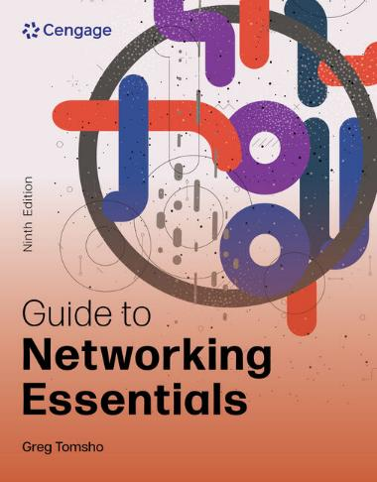
Guide to Networking Essentials, 9e
Chapter 14: Troubleshooting and Support
.

Slide 2
Chapter Objectives
By the end of this chapter, you should be able to:
Describe the benefits of documenting a network and list what elements should be documented
List the steps of the problem-solving process
Explain different approaches to network troubleshooting
Make use of problem-solving resources
Describe network troubleshooting tools
Summarize common troubleshooting situations
Describe disaster recovery procedures

Slide 3
Documenting Your Network
The following are reasons to document a network:
Makes equipment moves, adds and changes easier
Provides needed information for troubleshooting
Offers justification for additional staff or equipment
Helps determine compliance with standards
Supplies proof that your installations meet hardware or software requirements
Reduces training requirements and facilitates security management
Improves compliance with software licensing agreements

Slide 4
Change Management
In a network, a change is some procedure that requires modifications at workstations, such as changes of addresses, a NIC replacement, a software change, or a complete change in the workstation
When a workstation is moved, you must know which patch-panel and switch ports are currently being used so they can be disconnected
Without proper documentation, cables must be traced
Documenting changes in your network, which includes reasons for change, the potential impact of a change, notifications, and approval procedures, is called change management

Slide 5
Documentation and Troubleshooting
Physical and logical addressing, connectivity to devices, and even data about the cabling should be documented
Accurate documentation of workstation MAC addresses helps quickly find issues such as IP address conflicts and the source of invalid or excessive frames
When troubleshooting sessions that require protocol analysis, documentation provides the names and addresses of devices that are likely to be involved in a particular type of packet exchange you are troubleshooting

Slide 6
Documentation: IT Staffing and Standards Compliance
Documenting the type and frequency of support calls can provide justification for additions to staff or tools to make support more efficient
Statistics on network response time and bandwidth load as justification for upgrading servers or adding new equipment
Be sure to document which standards are in use
Example: Whether 568-A or 568-B wiring standard is used for patch panels and jacks
Many organizations that handle sensitive customer data need to show compliance with data security and handling standards

Slide 7
Documentation: Technical Support and Network Security
When solving a network device problem, some manufacturers of network devices will want to know that your cabling passed appropriate tests as well as other test results
When calling technical support for a software problem on one of your servers, the manufacturer will most likely want to know the hardware details as well as operating system version and patch installations
Physical and software security of devices, OSs with the latest security patches, and up-to-date malware protection should be documented
Documenting security patches and virus protection updates helps you adhere to your security policies and confirms resistance to current threats

Slide 8
What Should Be Documented? (1 of 2)
Some items you might want to document include the following:
Description of the network—Should include network topology, network technologies in use, the OSs installed, and the number of devices/users
Cable plant—Describes the physical layout of your network cabling, the terminations used, conventions used for labeling your cable and equipment, and results of test completed on the cable plant
Equipment rooms/telecommunications closets—Document the items in each room and their location

Slide 9
What Should Be Documented? (2 of 2)
Some items you might want to document include the following (continued):
Internetworking devices – Know what devices are connected to other devices, network management features, port usage, physical and logical addresses, model numbers, and hardware/software revision numbers
Servers – Document hardware configuration, operating system and application version numbers, NIC information, and system serial and model numbers
Workstations – Hardware and software configuration, physical and logical addresses
https://www.youtube.com/watch?v=CEZyq-fBn3w
Network Documentation

Slide 10
The Problem-Solving Process (1 of 2)
The following are the steps of the problem-solving process:
Determine the problem definition and scope
Gather information
Consider possible causes
Devise a solution
Implement the solution
Test the solution
Document the solution
Devise preventative measures

Slide 11
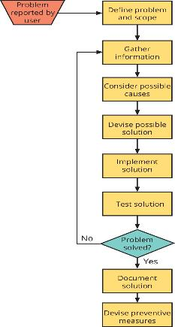
The Problem-Solving Process (2 of 2)
Figure 14-1 The problem-solving process

Slide 12
Step 1: Determine the Problem Definition and Scope
A problem definition should describe what does work and what doesn’t work
Questions to ask:
Is anyone else near you having the same problem?
What about other areas of the building?
Is the problem occurring with all applications or just one?
If you move to a different computer, does the problem occur there as well?

Slide 13
Step 2: Gather Information (1 of 2)
Know the right questions to ask:
Did It Ever Work?
When Did It Stop Working?
Does the problem occur all the time or only intermittently?
Are there particular times of the day when the problem occurs?
Are other applications running when the problem occurs?
Has Anything Changed?
Ask your self that question as well…Were any network changes made?

Slide 14
Step 2: Gather Information (2 of 2)
Know the right questions to ask (continued):
Never Ignore the Obvious
Check for unplugged cables
Define How It’s Supposed to Work
Have good documentation and a clear baseline of your network
A baseline of your network should include network utilization statistics; utilization statistics on server CPUs, memory, hard drives, and other resources; and normal traffic patterns
A baseline can help you determine whether reports of slow response time are valid

Slide 15
Step 3: Consider Possible Causes
Your goal in this step is to create a checklist of possible things that could have gone wrong
Example: An entire area of a building lost connection with the network, but no other areas are affected
The connection in the main wiring closet to the rest of the network has failed
The switch to which all workstations are connected has lost power or completely failed in some way
All workstations have acquired a virus through the network, and the virus affects their network connection

Slide 16
Step 4: Devise a Solution
Before devising a solution, consider the following:
Is there a way to test the proposed solution adequately?
What results should the proposed solution produce?
Depending on the scope of the problem and solution, you might need to do the following:
Save all network device configuration files
Document and back up workstation configurations
Document wiring closet configurations
Conduct a final baseline to compare new and old results

Slide 17
Step 5: Implement the Solution
Create Intermediate Testing Opportunities
Testing small steps in which a limited number of things could go wrong is easier than testing a complex solution with lots of problem areas
Inform Your Users
Inform your users of the possible disruption to some network services
Put the Plan into Action
Take notes about every change you make to the network or servers

Slide 18
Step 6: Test the Solution
If testing a workstation problem:
Attempt to log on to the network as a user with similar privileges as the main user
Next, attempt to access applications that would be run from that workstation
If testing a network upgrade:
Start some workstations on the upgraded part of the network and run some network-intensive applications
Gather information about how the network behaves and compare to previous results (before the upgrade)

Slide 19
Step 7: Document the Solution
Your documentation should include everything pertinent to the problem
Problem definition
Solution
Implementation
Testing
If the problem and its solution have implications for the entire network, include this information

Slide 20
Step 8: Devise Preventative Measures
After solving a problem, do everything you can to prevent this problem or similar problems from recurring
Example:
If your problem was a virus that spread throughout the network, install malware protection programs on your network and tighten policies for software and e-mail downloads
Devising preventive measures is proactive rather than reactive network management

Slide 21
Approaches to Network Troubleshooting: Trial and Error (1 of 3)
Trial-and-error requires an assessment of the problem, an educated guess to a solution and a test of the results
This approach can be used under the following conditions:
The system is being newly configured, so no data can be lost
The system is not attached to a live network
You can undo changes easily
Other approaches would take more time than a few trial-and-error attempts
There are few possible causes of the problem or no documentation to use

Slide 22
Approaches to Network Troubleshooting: Trial and Error (2 of 3)
The trial-and error method is not advisable under these conditions:
A server or internetworking device is live on the network
The problem is being discussed over the phone and you’re instructing an untrained user
You aren’t sure of the consequences of the solutions you propose
You have no sure way to undo the changes after they’re made
Other approaches will take the same amount of time

Slide 23
Approaches to Network Troubleshooting: Trial and Error (3 of 3)
Follow these guidelines when using this method:
Make only one change at a time before testing the results
Avoid making changes that might affect the operation of a live network
Document the original settings of hardware and software before making changes
Avoid making a change that can destroy user data
If possible, avoid making a change that you can’t undo
https://www.youtube.com/watch?v=yTU2jO9rlK4
Network Fundamentals 11-1: Troubleshooting Steps

Slide 24
Approaches to Network Troubleshooting: Solving by Example
Solving by example is the process of comparing something that doesn’t work with something that does
General rules to follow when using this method:
Use the solve-by-example approach only when the working sample has a similar environment as the problem machine
Don’t make configuration changes that will cause conflicts—Don’t change the TCP/IP address of a nonworking machine to the same address as a working machine
Don’t make any changes that could destroy data that can’t be restored

Slide 25
Approaches to Network Troubleshooting: The Replacement Method
Requires narrowing down possible sources of the problem and having known working replacement parts on hand so that they can be swapped out
Follow these rules when using this method:
Narrow the list of potentially defective parts down to a few possibilities
Make sure you have the correct replacement parts on hand
Replace only one part at a time
If your first replacement does not fix the problem, reinstall original part before replacing another part

Slide 26
Approaches to Network Troubleshooting: Step by Step with the OSI Model (1 of 2)
Part 2
In this approach, you test a problem starting at the Application layer and keep testing at each layer until you have a successful test or reach the Physical layer
You could also start at the Physical layer and work your way up
To use this approach, you must understand how networks work and where you should use troubleshooting tools
To see how this approach works, start by reviewing the simple network diagram in Figure 14-2

Slide 27
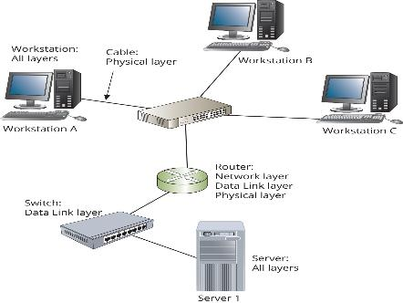
Approaches to Network Troubleshooting: Step by Step with the OSI Model (2 of 2)
Figure 14-2 Troubleshooting with the OSI Model

Slide 28
Knowledge Check Activity 14-1
Which of the following is a good rule to follow when using the replacement approach to problem solving?
a. Replace only one component at a time.
b. Disassemble the original part to see if it is broken.
c. Replace every component in the system.
d. Remove the part and then order a new one.

Slide 29
Knowledge Check Activity 14-1: Answer
Which of the following is a good rule to follow when using the replacement approach to problem solving?
Answer: a. Replace only one component at a time.
Explanation: The replacement method is effective only if the problem’s source can be determined and the source is a defective part. Follow these rules in order when using the replacement method: narrow the list of potentially defective parts down to a few possibilities; make sure you have the correct replacement parts on hand; replace only one part at a time; if your first replacement doesn’t fix the problem, reinstall the original part before replacing another part.

Slide 30
Making Use of Problem-Solving Resources
Resources available to you during the troubleshooting process:
Experience
The Internet
Network Documentation

Slide 31
Experience
Your most effective weapon in supporting the network and diagnosing and solving problems is your own experience
Take notes about what you see and learn
If It Happened Once, It Will Happen Again
Colleagues’ Experience
Experience from Manufacturer’s Technical Support
The best time to call is when you have a specific error number or message that you can report to the manufacturer
Have software version numbers or hardware’s serial number available when calling

Slide 32
The Internet
Most manufacturers create databases of problems and solutions so their customers can research the problem themselves (it is called a knowledge base or frequently asked questions (FAQ) document)
Use a knowledge base or search engine
Use AI Software
Find drivers and updates
Consult online support services and newsgroups

Slide 33
Network Documentation (1 of 3)
Your documentation should read like a user’s manual for network administrators
Network Diagrams
Include network diagrams showing a logical picture of the network and another diagram showing the network’s physical aspects (rooms, devices, and connections)
Internetworking Devices
Internetworking devices should be listed in table form and should include model and serial numbers, location, IP address, MAC address and # of ports (total and number of free ports)

Slide 34
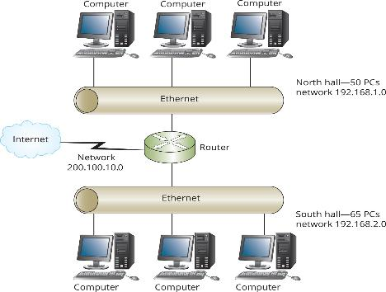
Network Documentation (2 of 3)
Figure 14-3 A logical network diagram

Slide 35
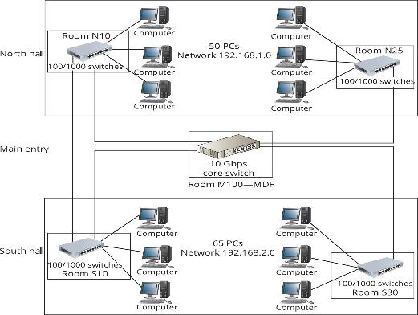
Network Documentation (3 of 3)
Figure 14-4 A physical network diagram

Slide 36
Network Troubleshooting Tools
Many networking problems occur at lower layers of the OSI model, where they are often difficult to troubleshoot
There are tools for diagnosing these problems
The next sections discuss some of the most common tools and their possible uses on a network

Slide 37
Using ping and tracert (1 of 4)
The ping command tells you whether your computer can communicate with another computer using IP
With a successful reply, you know that the target machine is running and there is a path between your computer and the target
This command also tells you the amount of time elapsed before a reply was received
A single ping message or even several messages in a row with long response times don’t necessarily indicate a problem
The computer or a network link might have been busy for a short time

Slide 38
Using ping and tracert (2 of 4)
You can verify the Network layer by trying the following checks:
Run ipconfig/all—this displays IP configuration
Ping loopback address—if you ping 127.0.0.1 and receive a successful response, you have verified the IP protocol is working properly
Ping local IP address—verifies that the computer can receive ICMP packets
Ping default gateway—default gateway is the address of the router the computer sends packets to when the destination is on another network
Ping IP address of host—verifies if you can communicate using ICMP of the target computer

Slide 39
Using ping and tracert (3 of 4)
Using tracert
The tracert command does a reverse DNS lookup on the IP address of each router and displays the name of the router
Response times can help you determine if there is a bottleneck between the source and destination
This command can also be used to confirm your network design
youtube.com/watch?v=e_AaBCf_aQ4
5 Windows Command Line Network Troubleshooting Tools

Slide 40
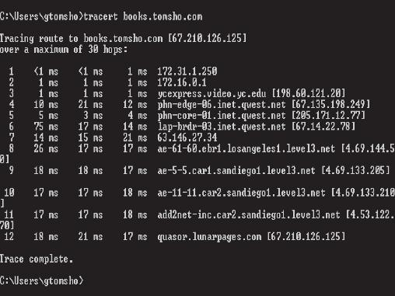
Using ping and tracert (4 of 4)
Figure 14-6 Output of the tracert command

Slide 41
Network Monitors
Network monitors are software packages that can track all or part of the network traffic
Network monitors can track packet type, errors, and traffic to and from each computer
They can also generate reports and graphs
Some programs can email administrators when a problem is detected

Slide 42
Protocol Analyzers
A protocol analyzer enables you to capture packets and analyze the network traffic generated by different protocols
Protocol analyzers can be used to troubleshoot problems related to DNS, authentication, DHCP, IP addressing, remote access, etc.
They can also used to create baselines for network performance
The most advanced analyzers combine hardware and software in a self-contained unit
Examples include: OmniPeek, EtherScope nXG, and Wireshark

Slide 43
Time-Domain Reflectometers
A time-domain reflectometer (TDR) can be used to determine whether there is a break or short in a cable and measure the cable’s length
The TDR sends an electrical pulse down the cable that reflects back when it encounters a break or short
It measures the time it takes for the signal to return and can estimate how far down the cable the fault is located
You should use a TDR to document actual lengths of all cables

Slide 44
Cable Testers
Basic cable testers usually cost less than $100
They only test the correct termination of a twisted-pair cable or the continuity of a coaxial cable
Basic cable testers cannot check for attenuation, crosstalk, noise, or other possible performance problems
Advanced Cable Testers
Advanced cable testers are more expensive than TDRs or basic cable testers
They perform several tests for crosstalk, attenuation, EMI, and impedance mismatches

Slide 45
Additional Tools
A multimeter can measure voltage, current, and resistance on a wire
Resistance (impedance) measures the opposition to electrical current and is important in determining faults
Tone generator and probe—a tone generator issues an electrical signal, and a probe (tone locator) detects the signal and emits a tone
Useful for locating a wire that might be in a bundle of other wires
Optical power meter (OPM)—an OPM is used to measure the amount of light on a fiber-optic circuit

Slide 46
Cabling and Related Components
The first step in troubleshooting physical layer problems is to determine whether the problem is with the cable or computer
You can check by connecting another computer to the cable
Make sure it is connected to the computer correctly and verify it is the right type of cable for the connection and that it is terminated correctly
Check the back of the NIC card to see if it has indicator lights
If NIC has no lights, you can try swapping out NICs

Slide 47
Switch Port Errors
When switches detect an error on a switch port, the link LED indicator may continuously blink from green to amber
Some commands to troubleshoot Cisco switches include the following:
show interfaces interface
show port-security interface interface
show interfaces status

Slide 48
Power Fluctuations
First, verify that the servers are functioning
One way to eliminate the effects of power fluctuations is to connect servers to uninterruptible power supplies (UPSs)
Use UPSs with battery power so they can be shut down without data loss (in the event of power loss)
At the very least, all computers, internetworking devices, and other electronic equipment should be protected by surge protectors

Slide 49
Upgrades
When you perform network upgrades:
Keep current and do one upgrade at a time to make your life easier
Test any upgrade before deploying it on your production network
Tell users about upgrades
They will be more understanding if they are notified beforehand

Slide 50
Poor Network Performance (1 of 2)
Performance problems can be addressed by asking the following questions:
What has changed since the last time the network functioned normally?
Has new equipment been added to the network?
Have new applications been added to computers on the network?
Is someone playing electronic games across the network?
Are there new users on the network? How many?
Could any other new equipment, such as a generator, cause interference near the network?

Slide 51
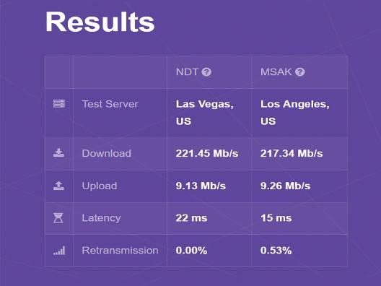
Poor Network Performance (2 of 2)
Figure 14-7 A speed test result from speed.measurementlab.net

Slide 52
Disaster Recovery
Disaster can be anything from a server disk crash to a fire or flood
This section focuses on:
Backup procedures
Recovery from system failure

Slide 53
Backing Up Network Data
To formulate your backup plan, review the following guidelines:
Determine what data should be backed up and how often
Develop a schedule for backing up your data
Identify the people responsible for performing backups
Test your backup system regularly
Maintain a backup log listing what data was backed up, when the backup took place, who performed the backup, and what media was used
Develop a plan for storing data after it has been backed up

Slide 54
Backup Types (1 of 2)
The following is a list of backup terminology:
Full backup—copies all selected files to the selected media and marks files as backed up
Incremental backup—copies all files changed since the last full or incremental backup and marks files as backed up
Differential backup—copies all files since the last file backup; doesn’t mark files as backed up
Copy backup—copies selected files to the selected media without marking files as backed up

Slide 55
Backup Types (2 of 2)
The following is a list of backup terminology (continued):
Daily backup—copies all files changed the day the backup is made; doesn’t mark files as backed up
Bare metal restore backup—designed to allow restoring the system disk directly from backup media without having to install the OS and backup software first
Of these backup types, full, incremental, and differential backups are most useful as part of a regular backup schedule
A good model for creating a backup schedule combines a weekly full backup with daily differential backups

Slide 56
Business Continuity
Business continuity consists of the policies, procedures, and resources required to ensure a business can function after a major catastrophe
If the bulk of IT infrastructure is maintained in house, the company should consider one of the following options:
Cold site—is a physical location that house the hardware needed to get IT functioning again
Warm site—is a location containing all infrastructure needed for operations to continue
Hot site—a location that can be running at a moment’s notice
youtube.com/watch?v=9cKWR2-4RLI
Hot vs Warm vs Cold DR Sites

Slide 57
Knowledge Check Activity 14-2
What is one way to eliminate the effects on servers caused by power outages and fluctuations?
a. Shut down servers during storms.
b. Connect servers to a surge protector.
c. Connect servers to a UPS.
d. Disconnect servers from the network when power outages occur.

Slide 58
Knowledge Check Activity 14-2: Answer
What is one way to eliminate the effects on servers caused by power outages and fluctuations?
Answer: c. Connect servers to a UPS.
Explanation: One way to eliminate the effects of power fluctuations, especially on servers, is to connect them to uninterruptible power supplies (UPSs). UPS systems provide battery power to computers so that they can be shut down without data loss in the event of a power outage.

Slide 59
Self Assessment
Based on the eight-step problem-solving process discussed in this chapter, what would be the first step you would take when troubleshooting a problem with network connectivity?
Name a question you would ask during the information-gathering step in the problem-solving process.

Slide 60
Summary
Now that the lesson has ended, you should be able to:
Describe the benefits of documenting a network and list what elements should be documented
List the steps of the problem-solving process
Explain different approaches to network troubleshooting
Make use of problem-solving resources
Describe network troubleshooting tools
Summarize common troubleshooting situations
Describe disaster recovery procedures

